Slide 1
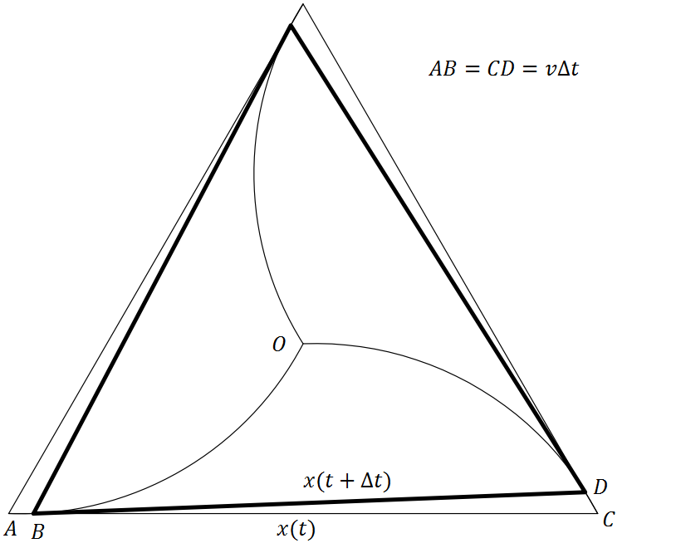
Geometric Monte Carlo Simulation
This problem asks if three particles start at the three vertices of a equilateral triangle, with a given side length, and they move into the triangle with a given velocity, where and when will they meet. I hope to make a simulation that depicts the movement of these particles so their movements can be clearly seen and visualized and the time it takes for them to meet can be shown down to the millisecond. This project will utilize skills learned in the maze solver, particle simulation, and drawing shapes projects. I will attempt to increase the scope of this simulation further by allowing for users to test the same concept on non-equilateral triangles or other shapes. This will mean that there will also be the opportunity to test the simulation with more than three particles, in the cause of shapes such as squares which have more than three vertices or circles which do not have a defined number of vertices.

